Slide 1
Polish Companies Bankruptcy Prediction
Group 16: Yilei Zhang
12/11/2021

Slide 2
Purpose of Project And Description of Dataset
Project Purpose:
Establish a company bankruptcy prediction model based on Polish companies' bankruptcy data.
Externally, the forecast results can be used as reference information for business investment, and internally, the forecast results can be used to evaluate self development.
Dataset:
Dataset comes from Emerging Markets Information Service, which is the world's most authoritative database of business information on emerging markets.
Dataset contains 64 numeric financial metrics from 5910 companies. These metrics evaluate business operation, for example, ‘net profit/total assets’, ‘gross profit/sales’, ‘current assets/short-term liabilities’, etc.
There are 410 bankrupted companies and 5500 firms that did not bankrupt on the same year when the data was collected. N-/N+ is 13.4.
No missing value is observed.

Slide 3
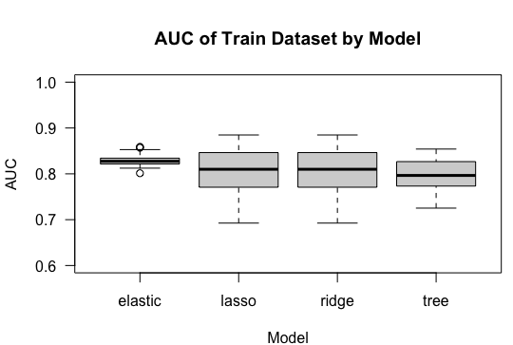
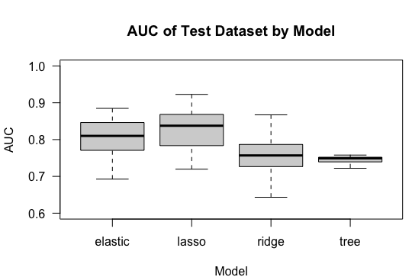
AUC for Test and Train by Model
Observations were weighted by the imbalance ratio in three logistic regression models. In tree model, ‘samplesize’ and ‘strata’ parameters were used to reduce the impact from imbalanced data.
Ridge logistic regression model and random forest tree model have overfitting issue comparing with other two models.
In 50 runs of Elastic-Net and Lasso logistic regression model, one or two failed to converge, leading to 0.5 AUC for both test and train. For clear and legible visualization purpose, I don’t show them in the boxplot.

Slide 4
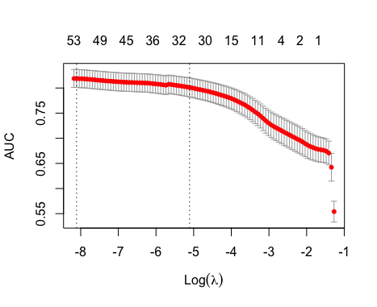
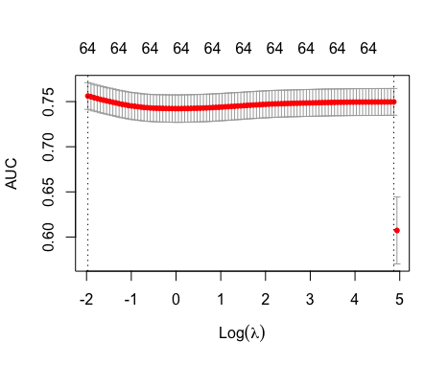
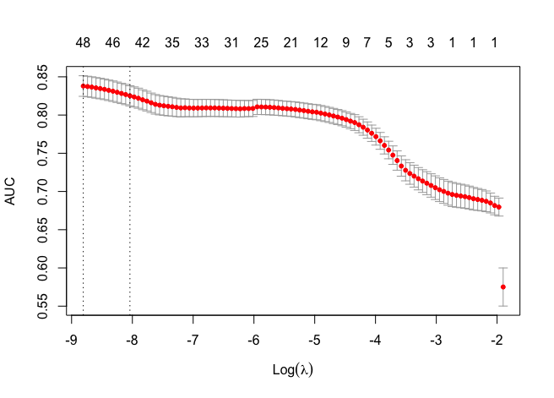
Cross Validation Curve and Train Time for Logistic Models
Elastic-net
Lasso
Ridge
Training Time: 2.73 sec
Training Time: 2.76 sec
Training Time: 3.27 sec
Also because of imbalanced dataset, I used AUC score to find the best lambda in cross validation.
When using minimum lambda, elastic-net logistic regression model shrinks features from 64 to 53, lasso shrinks features from 64 to 48, and because ridge doesn’t set any coefficients to 0, so the number of features in the model are still 64.

Slide 5
Median of Test AUC and Fitting Time
Models | Median of Test AUC | Time
Elastic-net | 0.81 | 3.13 secs
Lasso | 0.83 | 3.15 secs
Ridge | 0.75 | 3.70 secs
Random Forest Tree | 0.75 | 8.85 secs

Slide 6
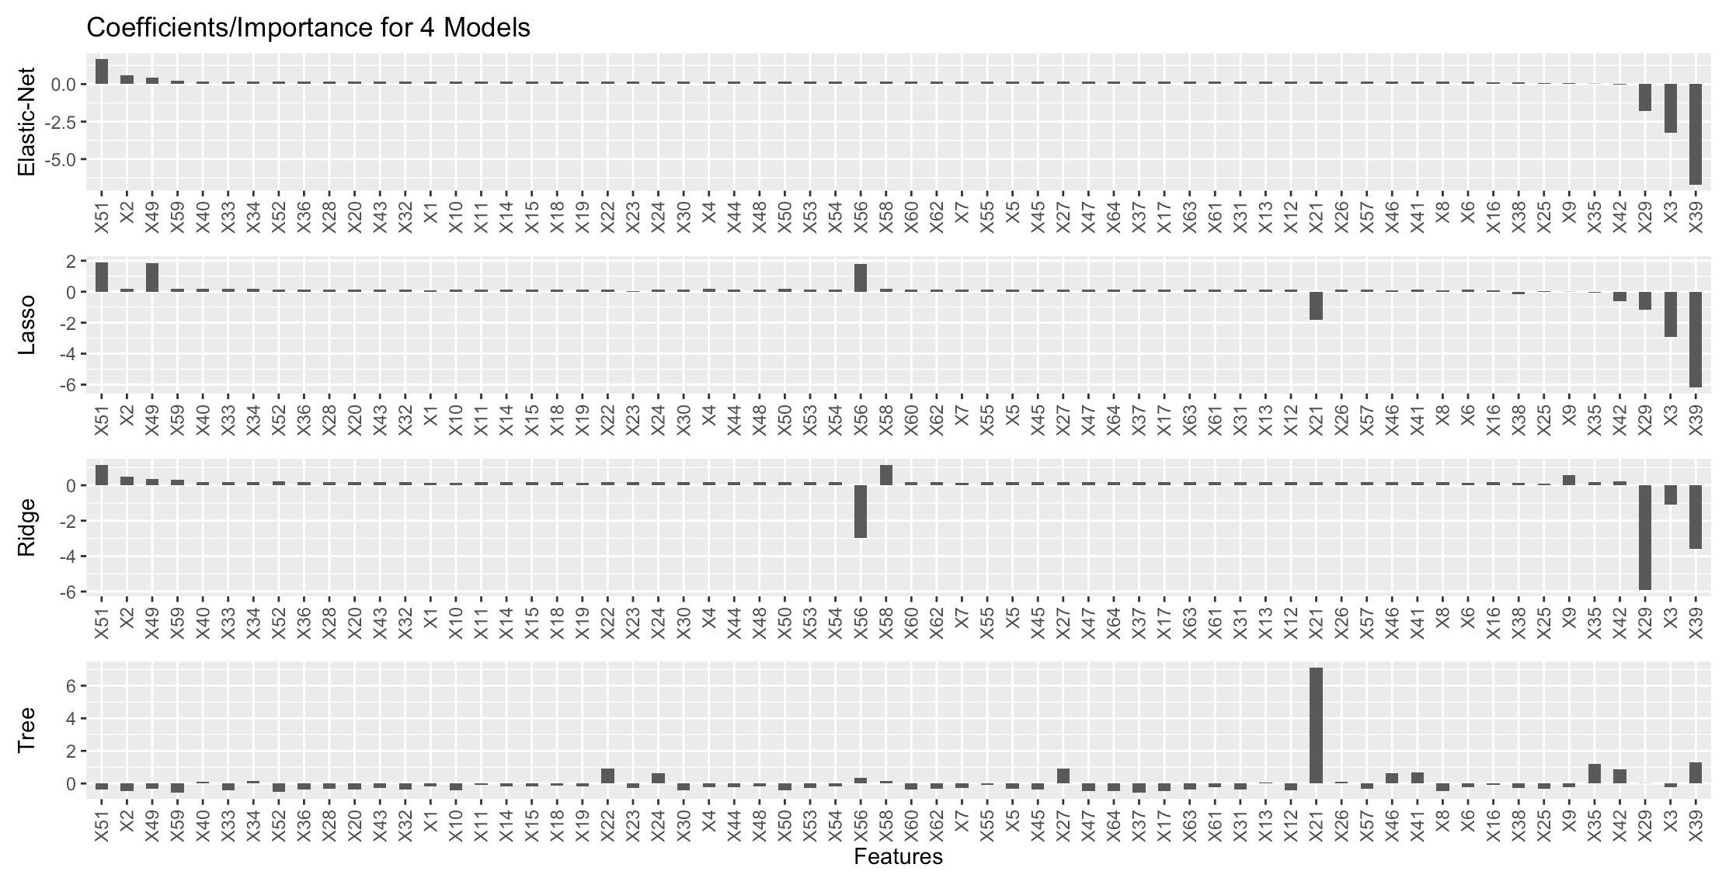
Coefficients/ Features Importance for Four Models

Slide 7
Conclusions
Lasso logistic regression model is the best choice considering the prediction performance and running time.
Below financial metrics are relatively important for predicting bankruptcy and evaluating the performance of a company.
No. | Features
X51 | (short-term liabilities * 365) / cost of products sold)
X49 | EBITDA (profit on operating activities - depreciation) / sales
X56 | (sales - cost of products sold) / sales
X21 | sales (n) / sales (n-1)
X29 | logarithm of total assets
X3 | working capital / total assets
X39 | profit on sales / sales

